Slide 1


Hopfield network
=============================================================================
WWW.THEMLLABS.COM || contact@themllabs.com || Phone : 91-7338339898, 91-6362546088

Slide 2
Agenda
Introduction
Properties of Hopfield network
Hopfield network derivation
Hopfield network Training
Hopfield network in optimization
=============================================================================
WWW.THEMLLABS.COM || contact@themllabs.com || Phone : 91-7338339898, 91-6362546088

Slide 3
Introduction
Hopfield neural network is proposed by John Hopfield in 1982 can be seen and network with associative memory.
can be used for different pattern recognition problems. It is a fully connected, single layer auto associative network
Means it has only one layer, with each neuron connected to every other neuron All the neurons act as input and output.
=============================================================================
WWW.THEMLLABS.COM || contact@themllabs.com || Phone : 91-7338339898, 91-6362546088

Slide 4
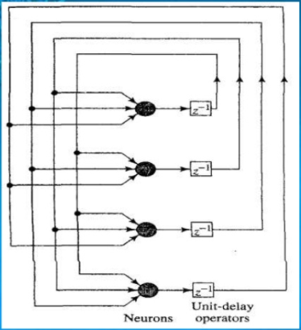
The Hopfield network(model) consists of a set of neurons and corresponding set of unit delays, forming a multiple loop feedback system as shown in figure.
The number of feedback loops is equal to the number of neurons.
The output of the neuron is feedback, via a unit delay element, to each of the other neurons in the network.
=============================================================================
WWW.THEMLLABS.COM || contact@themllabs.com || Phone : 91-7338339898, 91-6362546088

Slide 5
Properties of Hopfield network
A recurrent network with all nodes connected to all other nodes.
Nodes have binary outputs (either 0,1 or -1,1).
Weights between the nodes are symmetric .
No connection from a node to itself is allowed.
Nodes are updated asynchronously ( i.e. nodes are selected at 5 random).
The network has no hidden nodes or layer
=============================================================================
WWW.THEMLLABS.COM || contact@themllabs.com || Phone : 91-7338339898, 91-6362546088

Slide 6
Hopfield network
Consider the noiseless, dynamical model of the neuron shown in figure.
The synaptic weights w j1 ,w j2 ,...... w jn represents conductance’s.
The respective inputs x1 t , x 2 t ,...... x n t represents the potentials, N is number of inputs.
These inputs are applied to a current summing junction are:
Low input resistance
Unity current gain.
High output resistance
=============================================================================
WWW.THEMLLABS.COM || contact@themllabs.com || Phone : 91-7338339898, 91-6362546088

Slide 7
Hopfield network Training
Training a Hopfield net involves lowering the energy of states that the net should "remember". This allows the net to serve as a content addressable memory system, that is to say, the network will converge to a "remembered" state if it is given only part of the state.
The net can be used to recover from a distorted input to the trained state that is most similar to that input. This is called associative memory because it recovers memories on the basis of similarity.
=============================================================================
WWW.THEMLLABS.COM || contact@themllabs.com || Phone : 91-7338339898, 91-6362546088

Slide 8
For example, if we train a Hopfield net with five units so that the state (1, -1, 1, -1, 1) is an energy minimum, and we give the network the state (1, -1, -1, -1, 1) it will converge to (1, -1, 1, -1, 1).
Thus, the network is properly trained when the energy of states which the network should remember are local minima.
=============================================================================
WWW.THEMLLABS.COM || contact@themllabs.com || Phone : 91-7338339898, 91-6362546088

Slide 9
Hopfield network in optimization
The Hopfield network has been widely used for optimization. The idea of using the Hopfield network in optimization problems is straightforward
If a constrained/unconstrained cost function can be written in the form of the Hopfield energy function E, then there exists a Hopfield network whose equilibrium points represent solutions to the constrained/unconstrained optimization problem.
=============================================================================
WWW.THEMLLABS.COM || contact@themllabs.com || Phone : 91-7338339898, 91-6362546088

Slide 10
Minimizing the Hopfield energy function both minimizes the objective function and satisfies the constraints also as the constraints are “embedded” into the synaptic weights of the network.
Although including the optimization constraints into the synaptic weights in the best possible way is a challenging task, indeed many various difficult optimization problems with constraints in different disciplines have been converted to the Hopfield energy function.
=============================================================================
WWW.THEMLLABS.COM || contact@themllabs.com || Phone : 91-7338339898, 91-6362546088

Slide 11
Associative memory systems, Analog-to-Digital conversion, job-shop scheduling problem, quadratic assignment and other related NP-complete problems, channel allocation problem in wireless networks, mobile ad-hoc network routing problem, image restoration, system identification, combinatorial optimization, etc, just to name a few.
=============================================================================
WWW.THEMLLABS.COM || contact@themllabs.com || Phone : 91-7338339898, 91-6362546088

